Slide 1
Concorde NC Land Development
Student’s Name
Institutional Affiliation’s

Slide 2
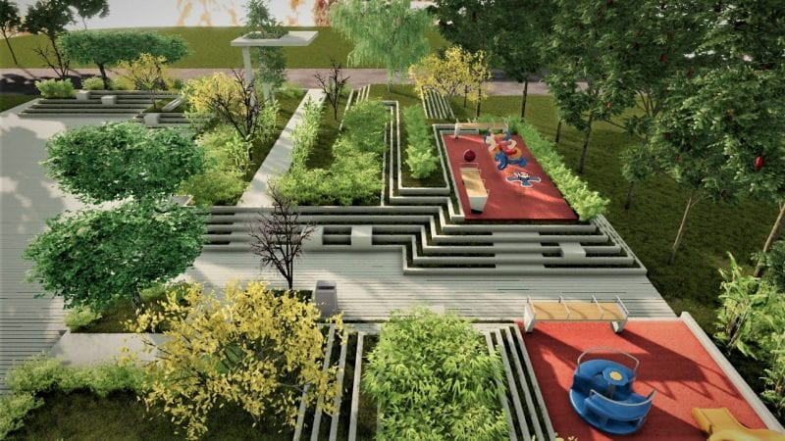
Land Development
Site Overview
-Situated to the west of St. Paul and Mississippi River northwest
-Used as dumping site for years until 2 years ago
-Extensive piece of flatland (4.3mPD to 5.8mPD)
Soil and Geotechnical conservation
-Comprises of two rock compisitions
-One side, strong pinkish brown soil
Slightly decomposed rocks
On the other side, faintly decomposed quartzite rock
Notes:
The project area is situated to the west of St. Paul and Mississipi River in the Northwest. The area is comprised of extensive piece of flatland at an elevation of 4.3mPD to 5.8MPD. The area is also surrounded by old river courses of Mississipi River. The geology of the area is characterized by two compositions of rock. First, the solid geology, which comprises of moderately strong pinkish brown and slightly, decomposed granite at the Southeast of the area.

Slide 3
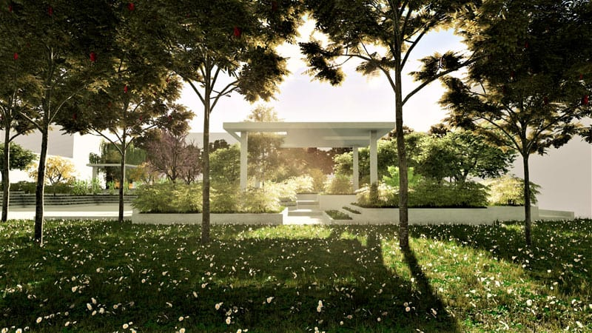
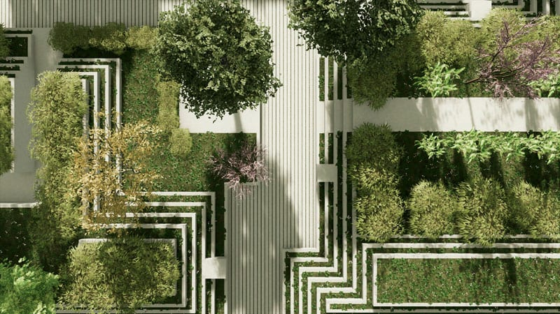
Continuation of Land Development
Project Phases
Preliminary- provides context
Design phase- identifying hypotheses
Technical analysis phase- choosing alternative
Open Space
-Urban open space to be adopted
Project involves green recreation area
This system will help resolve
changing challenges
Notes:
The project is supposed to take three faces; preliminary phase, design phase, and technical analysis phase. Preliminary phase provides the context and territorial planning of the project. Design phase follows the preliminary phase which involves identifying various hypotheses to help determine the most suitable arrangement. Technical analysis phase is the last phase which involves determining the best alternative to use. This project will adopt the urban open space concept. Since the project involves development of a green recreation area, the urban open space system will help in resolving the challenge of changing the virgin area into geometries.

